Slide 1
Monte-Carlo Methods & Temporal Difference Learning
AINT351 Machine Learning

Slide 2
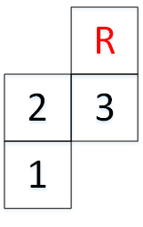

Grid Worlds
States
1, 2, 3
Actions
north (1), east (2), south (3), west (4)
Reward
10 if s = 3 and a = 1
0 otherwise

Slide 3
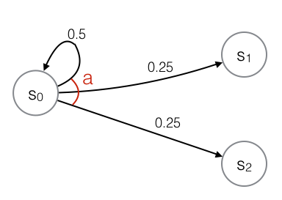
Transition Function
Model of the environment
S | A | S’=1 | S’=2 | S’=3
1 | 1 | 0.07 | 0.9 | 0.03
1 | 2 | 0.96 | 0.01 | 0.03
1 | 3 | 1.0 | 0.0 | 0.0
1 | 4 | 0.99 | 0.01 | 0.0
2 | 1 | 0.0 | 0.96 | 0.01
2 | 2 | 0.01 | 0.06 | 0.9
2 | 3 | 0.9 | 0.09 | 0.01
2 | 4 | 0.01 | 0.99 | 0.0
3 | 1 | 0.0 | 0.01 | 0.09
3 | 2 | 0.0 | 0.0 | 0.99
3 | 3 | 0.03 | 0.01 | 0.96
3 | 4 | 0.03 | 0.9 | 0.06

Slide 4
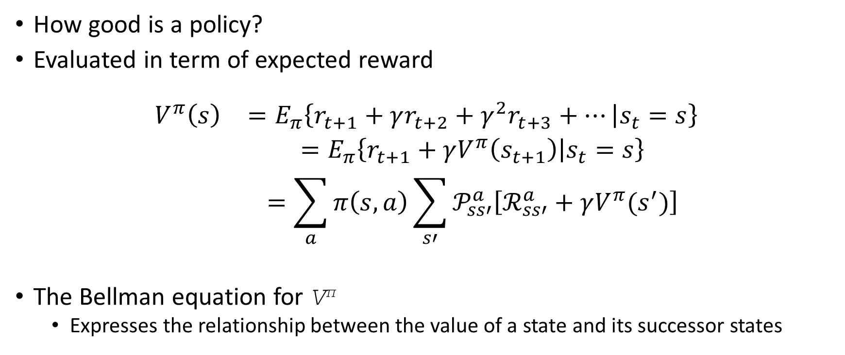
State-Value Functions
How good is a policy?
Evaluated in term of expected reward
$$\begin{matrix}V^{π}\left(s\right) & =E_{π}\left\{r_{t+1}+γr_{t+2}+γ^{2}r_{t+3}+… | s_{t}=s\right\} \\ & =E_{π}\left\{r_{t+1}+γV^{π}\left(s_{t+1}\right) | s_{t}=s\right\} \\ & =\sum_{a}{π\left(s,a\right)\sum_{s′}{𝒫_{ss′}^{a}\left[ℛ_{ss′}^{a}+γV^{π}(s^{′})\right]}}\end{matrix}$$
The Bellman equation for V^{π}
Expresses the relationship between the value of a state and its successor states

Slide 5
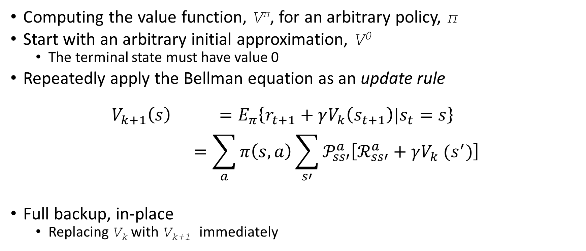
Policy Evaluation
Computing the value function, V^{π}, for an arbitrary policy, π
Start with an arbitrary initial approximation, V⁰
The terminal state must have value 0
Repeatedly apply the Bellman equation as an update rule
$$\begin{matrix}V_{k+1}\left(s\right) & =E_{π}\left\{r_{t+1}+γV_{k}\left(s_{t+1}\right)|s_{t}=s\right\} \\ & =\sum_{a}{π\left(s,a\right)\sum_{s′}{𝒫_{ss′}^{a}\left[ℛ_{ss′}^{a}+γV_{k} (s^{′})\right]}}\end{matrix}$$
Full backup, in-place
Replacing V_{k} with V_{k+1} immediately

Slide 6
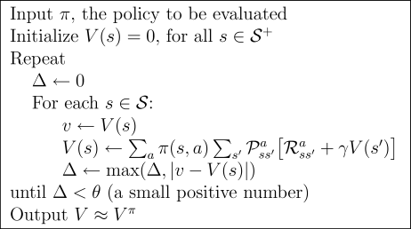
Iterative Policy Evaluation Algorithm

Slide 7
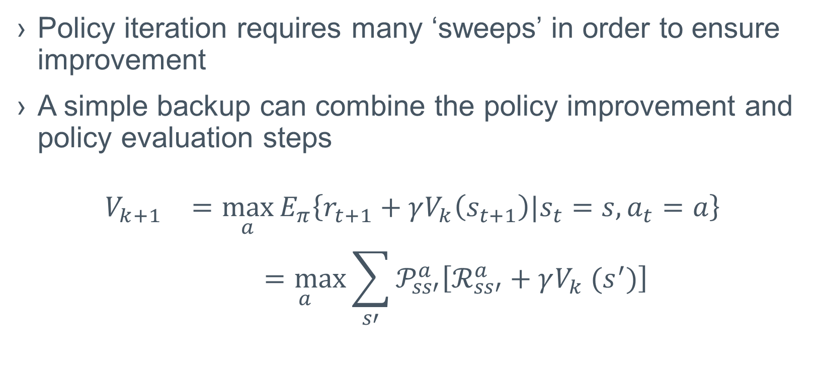
Value Iteration
Policy iteration requires many ‘sweeps’ in order to ensure improvement
A simple backup can combine the policy improvement and policy evaluation steps
$$\begin{matrix}V_{k+1} & =\max_{a}{E_{π}\left\{r_{t+1}+γV_{k}\left(s_{t+1}\right)|s_{t}=s,a_{t}=a\right\}} \\ & \underset{a}{=max}{\sum_{s′}{𝒫_{ss′}^{a}\left[ℛ_{ss′}^{a}+γV_{k} (s^{′})\right]}}\end{matrix}$$

Slide 8
Model-Free Algorithms
Estimate value functions directly
Do not represent the transition function
Transition probabilities will be implicitly included in the value function estimates

Slide 9
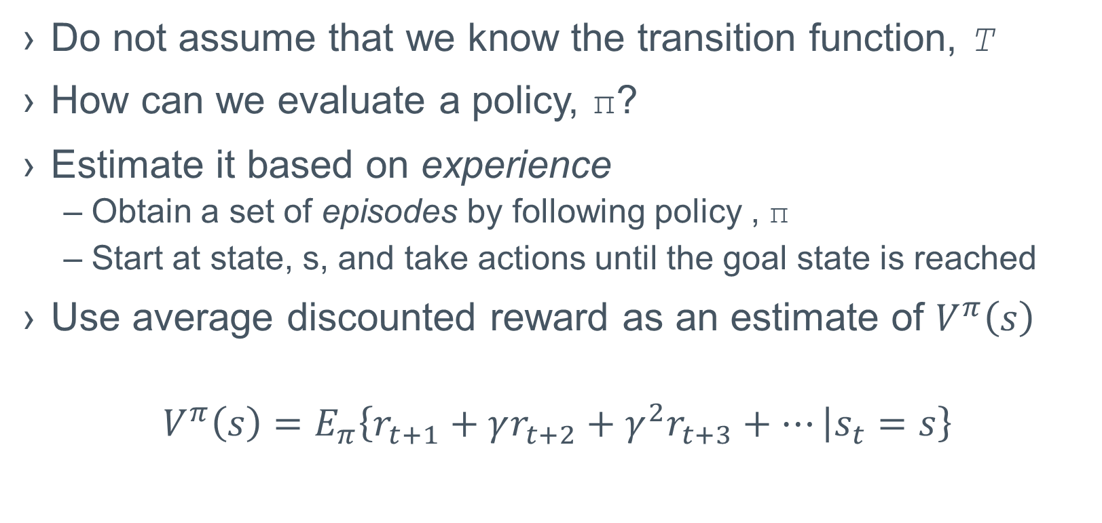
Monte-Carlo Methods
Do not assume that we know the transition function, T
How can we evaluate a policy, π?
Estimate it based on experience
Obtain a set of episodes by following policy , π
Start at state, s, and take actions until the goal state is reached
Use average discounted reward as an estimate of $V^{π}\left(s\right)$
$$V^{π}\left(s\right)=E_{π}\left\{r_{t+1}+γr_{t+2}+γ^{2}r_{t+3}+… | s_{t}=s\right\}$$

Slide 10
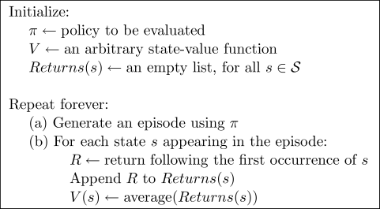
Monte-Carlo Policy Evaluation Algorithm
Only consider first visit

Slide 11
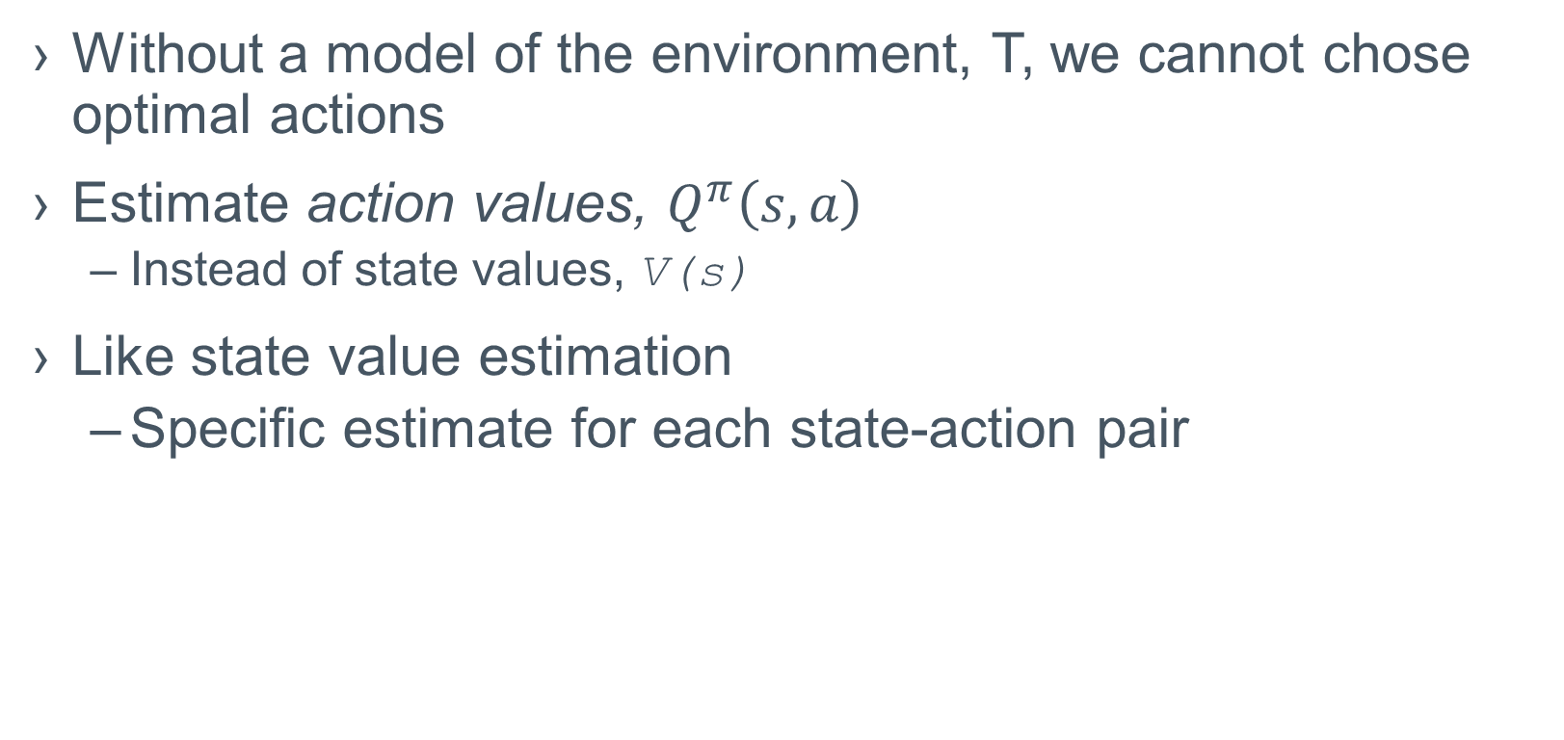
Estimating Action Values
Without a model of the environment, T, we cannot chose optimal actions
Estimate action values, $Q^{π}\left(s,a\right)$
Instead of state values, V(s)
Like state value estimation
Specific estimate for each state-action pair

Slide 12
Exploring Starts
If π is a deterministic policy, we may never visit some state-action pairs
Guarantee that all first step of each episode gives all state-action pairs a non-zero probability
Ignore policy on first step

Slide 13
Temporal Difference Learning
Like Monte-Carlo
Learns from experience without a model, T
Like Dynamic Programming
Estimate value estimates based on other existing value estimates
Wait one step until the return following a visit to state, s, and action, a, is known
What was the reward
What was the resulting state
Use observation to update the value function
Don’t wait until the goal state is reached

Slide 14
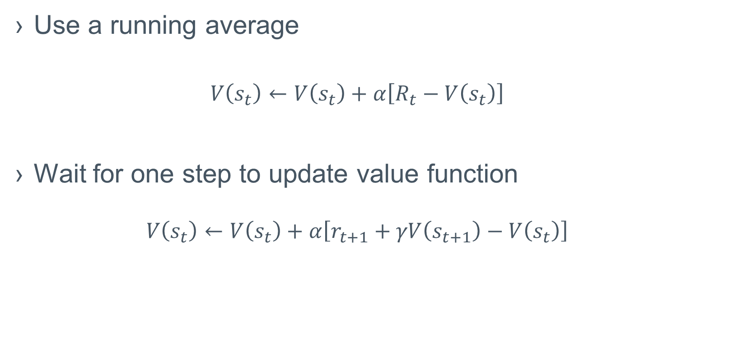
TD Prediction
Use a running average
$$V\left(s_{t}\right)←V\left(s_{t}\right)+α\left[R_{t}−V\left(s_{t}\right)\right]$$
Wait for one step to update value function
$$V\left(s_{t}\right)←V\left(s_{t}\right)+α\left[r_{t+1}+γV\left(s_{t+1}\right)−V\left(s_{t}\right)\right]$$

Slide 15
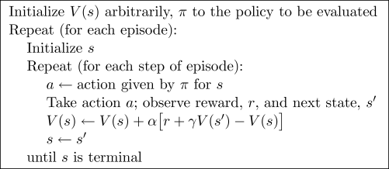
TD(0) Algorithm
Policy evaluation

Slide 16
Advantages of TD Prediction
Do not need a model of the environment
They bootstrap
Learn a guess from a guess
They work in an on-line fashion
No need to wait for terminal state
Update every time step
Do not have to ignore complete episodes with off-policy actions
More scope for exploring

Slide 17
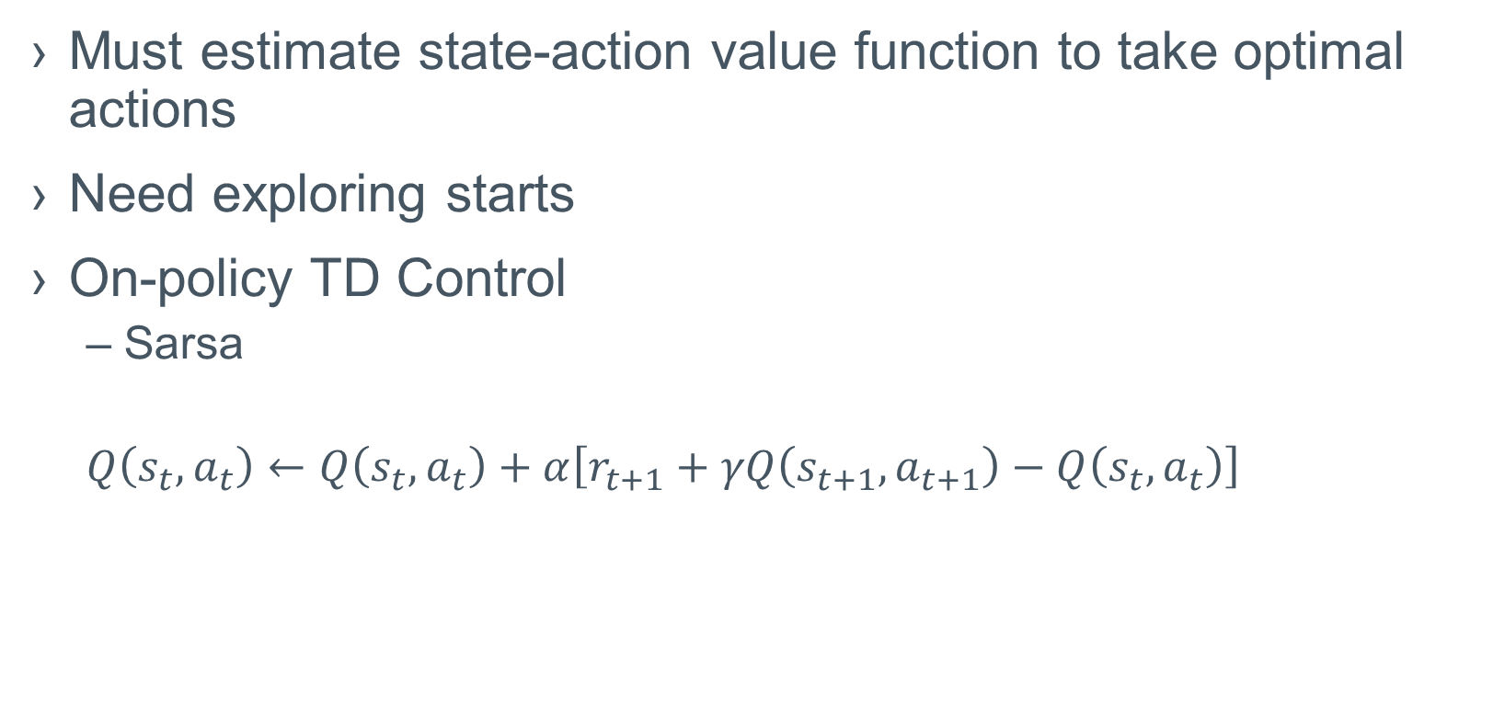
TD Control
Must estimate state-action value function to take optimal actions
Need exploring starts
On-policy TD Control
Sarsa
$Q\left(s_{t},a_{t}\right)←$ $Q\left(s_{t},a_{t}\right)+α\left[r_{t+1}+γQ\left(s_{t+1},a_{t+1}\right)−Q\left(s_{t},a_{t}\right)\right]$

Slide 18
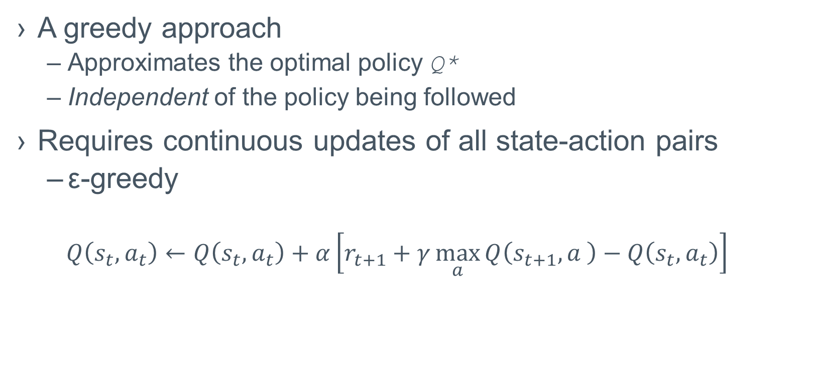
Q-Learning
A greedy approach
Approximates the optimal policy Q*
Independent of the policy being followed
Requires continuous updates of all state-action pairs
ε-greedy
$$Q\left(s_{t},a_{t}\right)←Q\left(s_{t},a_{t}\right)+α\left[r_{t+1}+γ\max_{a}{Q\left(s_{t+1},a \right)−Q\left(s_{t},a_{t}\right)}\right]$$

Slide 19
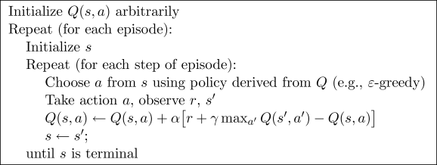
Q-Learning Algorithm

Slide 20
Episodes
An episode is on traversal of the given environment
From a (random) start state to a terminal (goal) state

Slide 21
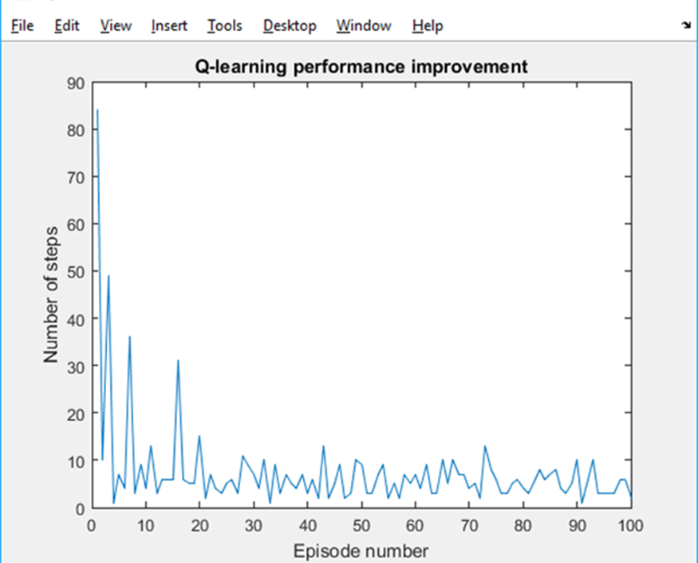
Trials
A trial consists of multiple episodes
The algorithm learns throughout a trial
All trials use and update the same Q-function
When do we stop?
Convergence
Minimum change in mean performance
Moving average

Slide 22
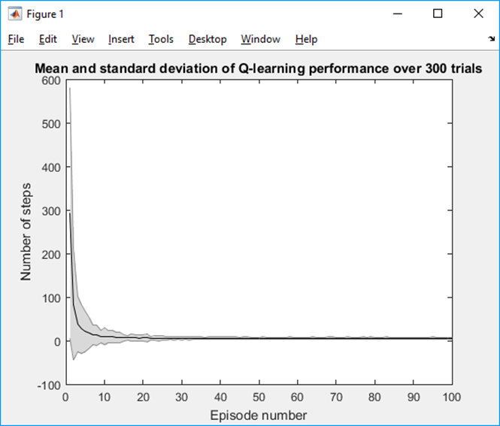
Experiments
Multiple trials
The algorithms forgets what it has learnt between trials
Provides mean and standard deviation of performance at each episode
Learning reduces variation as well as mean performance

